Slide 1
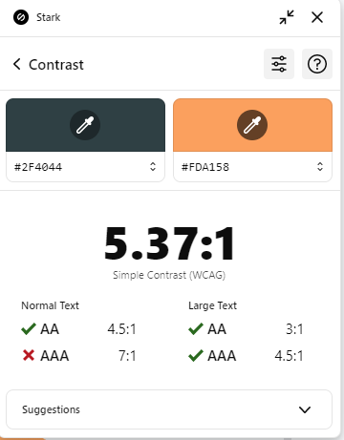
OSC
SCIENCE & TECH COMMITTEE
.NET (LINQ)
Mahmoud Hossam

Slide 2
Agenda
LINQ
EF CORE
MVC
MVC
MVC
APIs

Slide 3
Table of contents
01
02
03
04
05
Pre-LINQ Essentials
LINQ FROM SCRATCH
LINQ TYPES
What is VAR, Delegate, and Lambdas
Problem & Linq Solution
Query & Method Syntax
06
EXECUTION TIME
IN & OUT TYPES
LINQ STATMENTS
Deferred & Immediate
Common statements
ex where, select , …
Single & sequence

Slide 4
01
Pre-LINQ Essentials

Slide 5

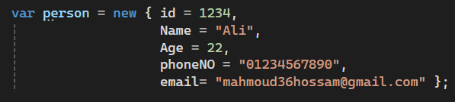

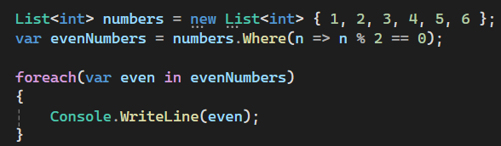

KEYWORD “var”
When the type is obvious
When the type is long or complex
Or
With Anonymous Type
4. With LINQ Queries

Slide 6
LAMBDA EXPRESSION

Slide 7
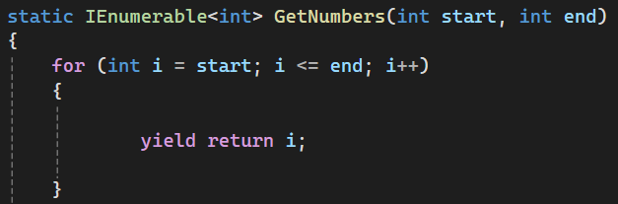
YIELD RETURN

Slide 8


Slide 9
TYPES OF DELEGATES
A delegate is a type-safe function pointer that allows methods to be passed as parameters and called dynamically.
ACTION
FUNC
PREDICATE
Performs an operation with input parameters and returns nothing (void)
Takes input parameters and returns a value of a specified type.
Ex. Int, string, …
Takes one input and returns a bool, used for conditions and filtering.

Slide 10
02
LINQ FROM SCRATCH

Slide 11
03
LINQ TYPES

Slide 12


Maybe you need to divide the content
QUERY SYNTAX
METHOD SYNTAX

Slide 13
04
EXECUTION TIME

Slide 14
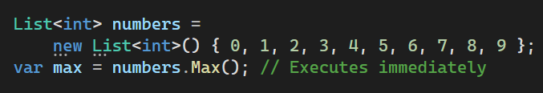
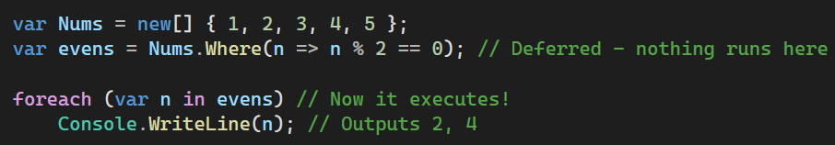
IMMEDIATE EXECUTION
DEFERRED EXECUTION
LINQ runs as soon as the statement is reached.
LINQ only runs when you iterate over the result

Slide 15
05
IN & OUT TYPES

Slide 16
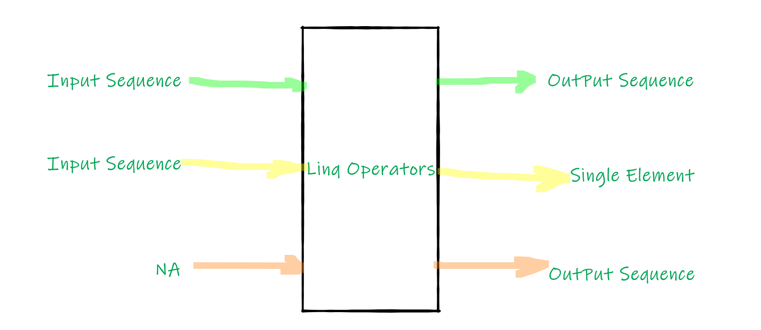


Divide the content in five ideas
1. Input Sequence ➜ LINQ ➜ Output Sequence
2. Input Sequence ➜ LINQ ➜ Single Element
3. No Input (N/A) ➜ LINQ ➜ Output Sequence

Slide 17
BREAK

Slide 18
06
LINQ STATMENTS

Slide 19
Hands on (time 15 min)
Q1- Find the first movie(alphabetically) whose title starts with the letter "I".
Q2- Retrieve a list of movies with a title length greater than 10 characters, and project only the title and ID.
Q3- Get a list of all movie titles that contain the word "The" and sort them alphabetically.
Q4- Skip the first 2 movies(ordered by title) and take the next 3, Return only their titles.
Q5- Count the total number of unique directors who have made at least one movie.

Slide 20
Thank you !

